Slide 1
CSE302-Software Quality Engineering Software Quality Factors
Instructor: Sobia Usman
Assistant Professor
CS - CUI, LHR

Slide 2
Requirements
IEEE Standard defines it as
“A condition or capability needed by a user to solve a problem or achieve an objective
A condition or capability that must be met or possessed by a system...to satisfy a contract, standard, specification, or other formally imposed document”

Slide 3
Levels of Requirements
Business Requirements
These are used to state the high-level business objectives of the organization or customer requesting the system or product.
They are used to document main system features and functionalities without going into their nitty-gritty details.
They are captured in a document describing the project vision and scope.
User Requirements
User requirements add further detail to the business requirements.
They are called user requirements because they are written from a user’s perspective and the focus of user requirement is on describing the tasks that the user must be able to accomplish in order to fulfill the above stated business requirements.
They are captured in the requirement definition document.

Slide 4
Functional Requirements
The next level of detail comes in the form of what is called functional requirements.
They bring in the system’s view and define from the system’s perspective
Services the system should provide
How the system should react to particular input
How the system should behave in a particular situations
or
What the system should not do

Slide 5
Non-Functional Requirements
The requirement document should not only describe the functionality needed and provided by the system, but it must also specify the constraints under which it must operate.
These kinds of requirements are called Non-Functional Requirements.
These are the constraints on the services or functions offered by the system
Include timing constraints ,constraints on the development process and standards

Slide 6
Non-Functional Requirements

Slide 7
Requirements Engineering Process
Requirements elicitation
Determining what the customer requires
Requirements analysis and negotiation
Understanding the relationships among various customer requirements
and shaping those relationships to achieve a successful result
Requirements specification
Building a tangible model of requirements

Slide 8
Requirements Defects
All four categories of defects (errors of commission, errors of omission, errors of clarity and ambiguity, and errors of speed and capacity) are found in requirements
Errors of commission (something is done that is wrong)
Errors of omission (something was left out by accident)
Errors of clarity and ambiguity, (two people reach different interpretations of what is meant)
Errors of speed or capacity (the application works, but not fast enough)
If not prevented, requirements defects usually flow downstream into design, code, and user manuals

Slide 9
Prevention Vs Removal
For requirements errors, prevention is usually more effective than removal
JAD and prototyping are more effective in defect prevention
Requirements inspections and prototyping play an important role in defect removal

Slide 10
Validating Requirements
Requirements need to be validated for
consistency
testability
performance issues
conformance to local/national laws
conformance to company policies
availability of technology

Slide 11
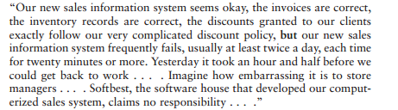
Need for Comprehensive Software Quality Requirements

Slide 12
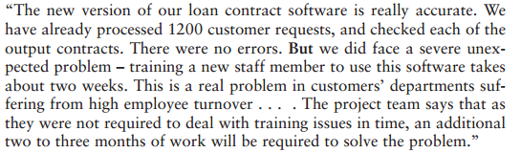
Need for Comprehensive Software Quality Requirements

Slide 13
Need for Comprehensive Software Quality Requirements
Mostly software projects satisfactorily fulfilled the basic requirements for correct calculations (correct inventory figures, correct average class’s score, correct loan interest, etc.)
Software projects suffered from poor performance in important areas such as maintenance, reliability, software reuse, or training.
Cause for the poor performance -> lack of predefined requirements

Slide 14
Classifications of Requirements into Software Quality Factors
Attributes of Software and its use and maintenance – defined in SRS can be classified into content groups called quality factors.
The classic model of software quality factors, suggested by McCall, consists of 11 factors (McCall et al.,1977)
The McCall factor model continues to provide a practical, up-to-date method for classifying software requirements(Pressman, 2000).

Slide 15
McCall’s Quality Factors
McCall’s factor model classifies all software requirements into 11 software
quality factors.
The 11 factors are grouped into three categories:
Product Operation Factors
How well it runs….
Correctness, reliability, efficiency, integrity, and usability
Product Revision Factors
How well it can be changed, tested, and redeployed.
Maintainability; flexibility; testability
Product Transition Factors
How well it can be moved to different platforms and interface with other systems
Portability; Reusability; Interoperability

Slide 16
McCall's Software Quality
Factors Model
Software Quality Factors
Product operation factors
Product revision factors
Product transition factors

Slide 17
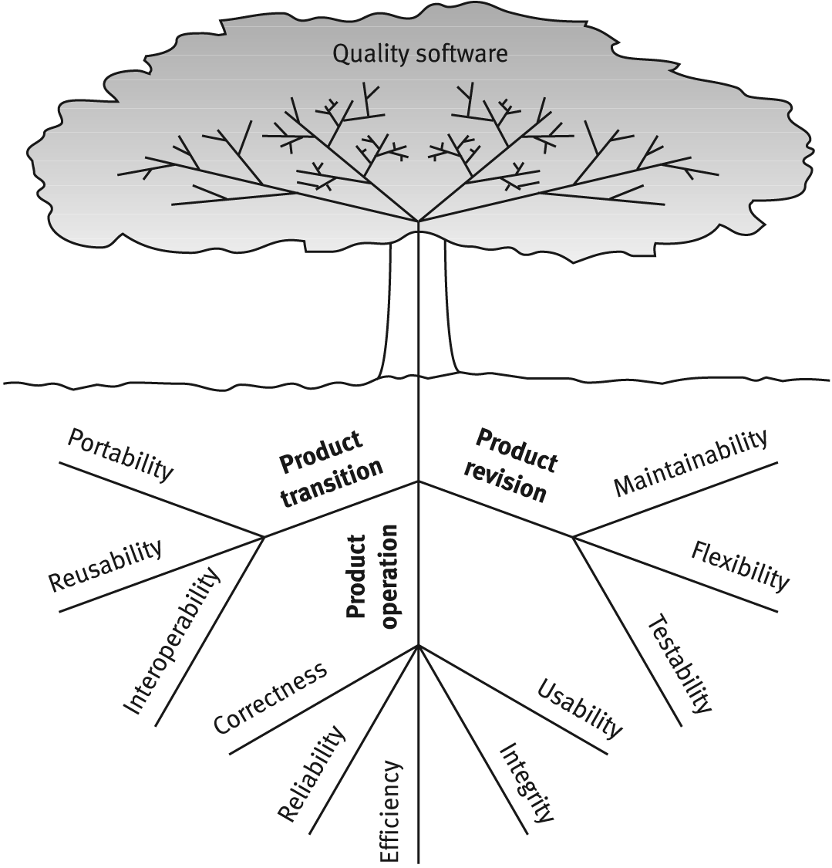
McCalls Factor Model Tree

Slide 18
Product Operation Factors
Correctness
Reliability
Efficiency
Integrity
Usability
How well does it run and ease of use.

Slide 19
Product Operation Factors
According to McCall’s model, five software quality factors are included in the product operation category, all of which deal with requirements that directly affect the daily operation of the software
Correctness
Correctness requirements are defined in a list of the software system's required outputs, such as a query display of a customer’s balance in the sales accounting information system
The output mission (e.g., sales invoice printout)
The required accuracy of those outputs
The completeness of the output information
The availability of the information
The standards for coding and documenting the software system.

Slide 20
Example
The correctness requirements of a club membership information system consisted of the following:
The output mission: A defined list of 11 types of reports, eight types of queries, which were to be displayed on the monitor on request.
The required accuracy of the outputs: The probability for a non-accurate output, containing one or more mistakes, will not exceed 1%.

Slide 21
Example
The completeness of the output information: The probability of missing data about a member, his attendance at club events, and his payments will not exceed 1%.
The availability of information: Reaction time for queries will be less than two seconds on average; the reaction time for reports will be less than four hours.
The required standards and guidelines: The software and its documentation are required to comply with the client’s guidelines and standards.

Slide 22
Product Operation Factors
2. Reliability Requirements
Reliability requirements deal with the failure to provide service.
Example :
The failure frequency of a heart-monitoring unit that will operate in a hospital’s intensive care ward is required to be less than one in 20 years. Its heart attack detection function is required to have a failure rate of less than one per million cases.

Slide 23
Product Operation Factors
Efficiency Requirements
Deals with the hardware resources needed to perform the functions of the software.
The main hardware resources to be considered are the computer’s
processing capabilities (measured in MIPS – million instructions per second, MHz or megahertz etc.), its data storage capability in terms of memory and disk capacity (measured in MBs – megabytes, GBs – gigabytes, etc.) and the data communication capability of the communication lines (usually measured in KBPS – kilobits per second., etc)
The requirements may include the maximum values at which the hardware resources will be applied in the developed software system

Slide 24
Product Operation Factors
4. Integrity – deal with system security that prevent unauthorized persons access.
5. Usability – deals with the scope of staff resources needed to train new employees and to operate the software system.

Slide 25
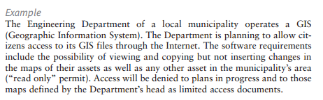
Product Operation Factors :Integrity

Slide 26
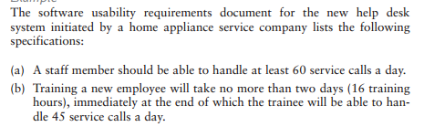
Product Operation Factors : Usability

Slide 27
Product Revision Factors
Maintainability
Flexibility
Testability
Can I fix it easily, retest, version it, and deploy it easily?

Slide 28
Product Revision Factors
According to the McCall model of software quality factors, three quality factors comprise the product revision category.
These factors deal with those requirements that affect the complete range of software maintenance activities:
corrective maintenance (correction of software faults and failures)
perfective maintenance (enhancement and improvement of existing software).

Slide 29
Product Revision Factors
Maintainability Requirements
The degree of effort needed to identify reasons (find the problem) for software failure and to correct failures and to verify the success of the corrections.
Deals with the modular structure of the software, internal program documentation and programmer manuals.
Typical maintainability requirements:
The size of a software module will not exceed 30 statements.
The programming will according to the company coding standards and Guidelines

Slide 30
Product Revision Factors
Flexibility – deals with resources to change (adopt) software to different types of customers
These include the resources (i.e. in man-days) required to adapt a software package to a variety of customer
This factor also support perfective maintenance activities, such as changes and additions to the software in order to improve its service.

Slide 31
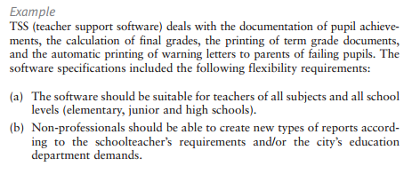
Flexibility: Example

Slide 32
Product Revision Factors
3.Testability Requirements
Testability requirements deal with the testing of an information system as well as with its operation.
Testability requirements for the ease of testing are related to special features in the programs that help the tester, by providing predefined intermediate results and log files.
Related to software operation include automatic diagnostics performed by the software system prior to starting the system, to find out whether all components of the software system are in working order and to obtain a report about the detected faults.

Slide 33


Testability : Example

Slide 34
Product transition factors
Portability
Reusability
Interoperability
Can I move the app to different hardware? Interface easily with
different hardware / software systems; can I reuse major portions
of the code with little modification to develop new apps?

Slide 35
Product Transition Factors
Portability Requirements:
Portability requirements tend to the adaptation of a software system to other environments consisting of different hardware, different operating systems, and so forth.
2. Reusability Requirements: Are we able to reuse parts of the app for new applications?
Can save immense development costs due to errors found / tested.
Very big deal nowadays.

Slide 36
Portability
Example
A software package designed and programmed to operate in a Windows 2000 environment is required to allow low-cost transfer to Linux and Windows NT environments.

Slide 37
Reusability
Example
A software development unit has been required to develop a software system for the operation and control of a hotel swimming pool that serves hotel guests and members of a pool club. Although the management did not define any reusability requirements, the unit’s team leader, after analyzing the information processing requirements of the hotel’s spa, decided to add the reusability requirement that some of the software modules for the pool should be designed and programmed in a way that will allow its reuse in the spa’s future software system, which is planned to be developed next year.
These modules will allow:
Entrance validity checks of membership cards and visit recording.
Restaurant billing.
Processing of membership renewal letters.

Slide 38
Product Transition Factors
Interoperability Requirements:
Interoperability describes the extent to which systems and devices can exchange data and interpret that shared data.
For two systems to be interoperable, they must be able to exchange data and present that data such that it can be understood by a user

Slide 39
Example
The firmware of a medical laboratory’s equipment is required to process its results (output) according to a standard data structure that can then serve as input for a number of standard laboratory information systems.

Slide 40
Conclusion
Requirements engineering and software quality are tightly-coupled
Requirements engineering must be performed in a way that results in the development of high quality software
Requirements defects can have devastating impact on the software project/product
Defect prevention works better than removal

Slide 41
Practice Question
Review Questions 3.2,3.5
Topics for discussion 3.3.

Slide 42
References
Chapter 3, Software Quality Factors, Software Quality Assurance from theory to implementation by Daniel Galin

